Slide 1

Problem Statement
The hotel industry faces challenges in managing bookings, cancellations, and customer satisfaction while maximizing revenue and operational efficiency. Build a Power Bi project that aims to analyze booking and cancellation trends, guest and revenue patterns, market segment performance, and key operational metrics to identify actionable insights for improved decision-making.

Slide 2
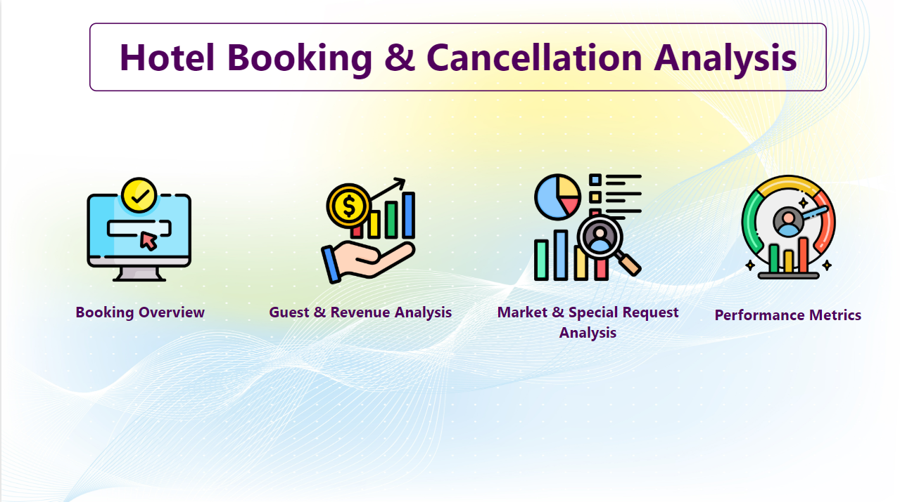

Slide 3
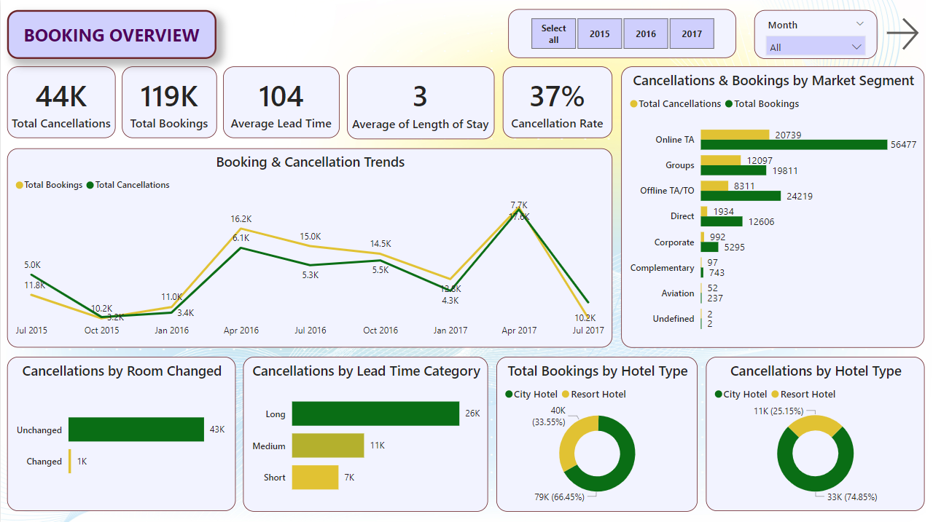
Booking Overview: Analyzes booking and cancellation trends to identify key drivers and patterns across hotel types.

Slide 4
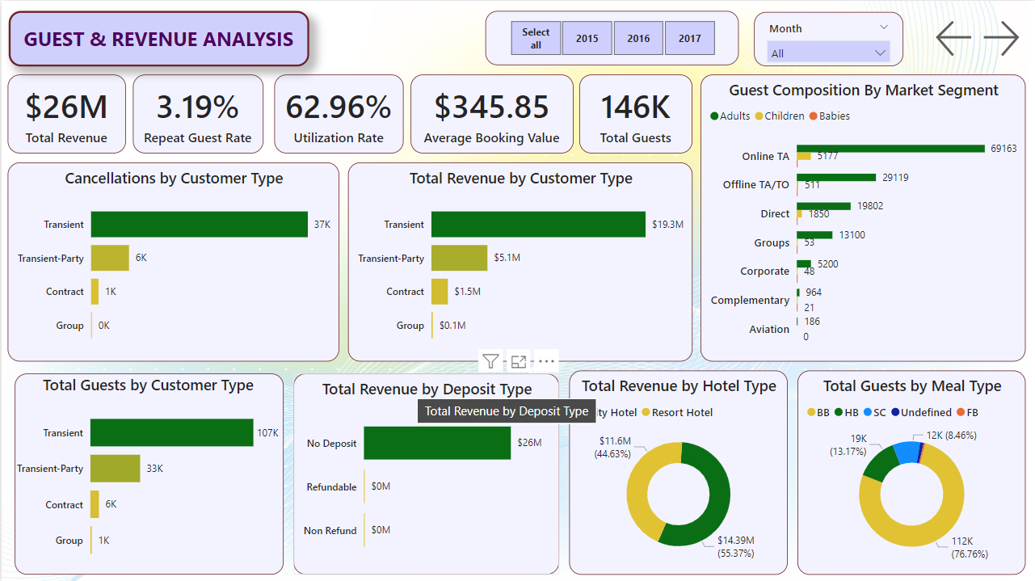
Guest and Revenue Analysis: Analyzes guest demographics and revenue contributions to optimize profitability and retention.

Slide 5
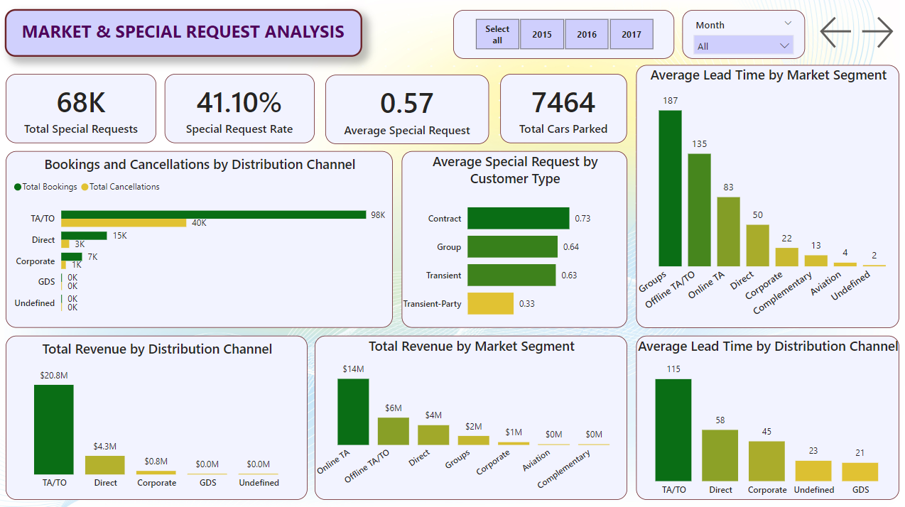
Market and Special Request Analysis: Evaluates the performance of market segments and guest preferences to improve operational strategies.

Slide 6
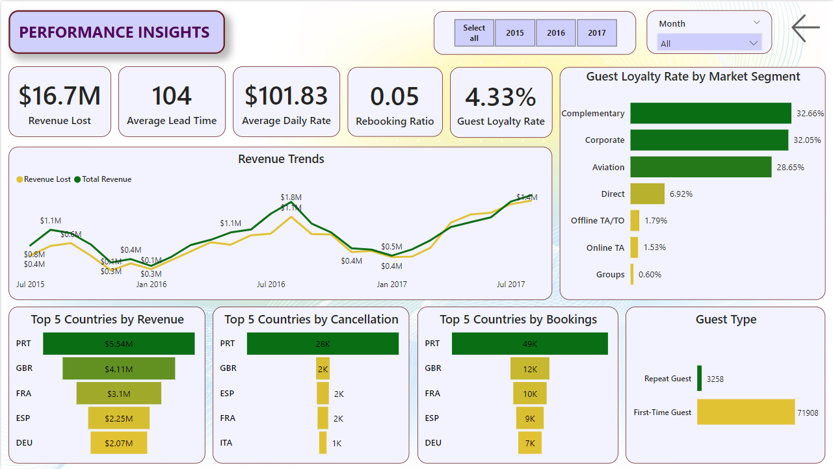
Performance Insights: Highlights key performance metrics and trends to support strategic decision-making.

Slide 7
Insights:
Booking and Cancellation trends showed almost similar trends. Cancellations increase as bookings increase and decrease as bookings decrease.
Bookings and cancellations show rise from January to April and a fall after that.
Lead time categories with longer durations showed higher cancellation rates.
City Hotels had considerable higher bookings and cancellations than Resort Hotels.
Online Travel Agencies contributed to the most number of bookings, cancellations and guests.
Cancellations were not affected much by room changes.
Transient Customers contributed the most to total guests, cancellation and revenue.
City Hotels had higher revenue than Resort Hotels.
Around 77% guests chose bed and breakfast meal plan.
Almost the entire revenue was generated on no deposit type bookings.
Travel Agencies had the highest bookings, cancellations, revenue and lead time.
Portugal had the most bookings, cancellation and revenue generated.
Revenue trends show rise from January to August and a decrease thereafter.
Complementary, Corporate and Aviation segment guests are the most loyal customers.

